Slide 1
Responsive Design and
Introduction to Bootstrap

Slide 2
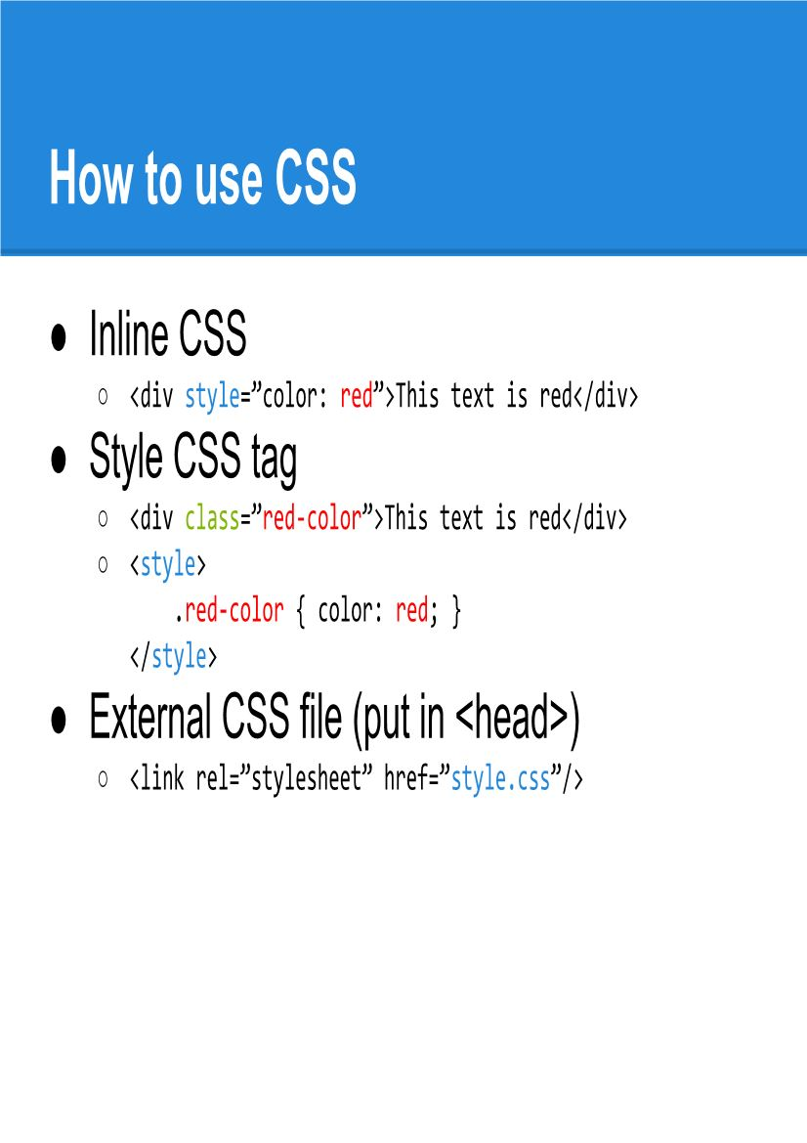

Slide 3
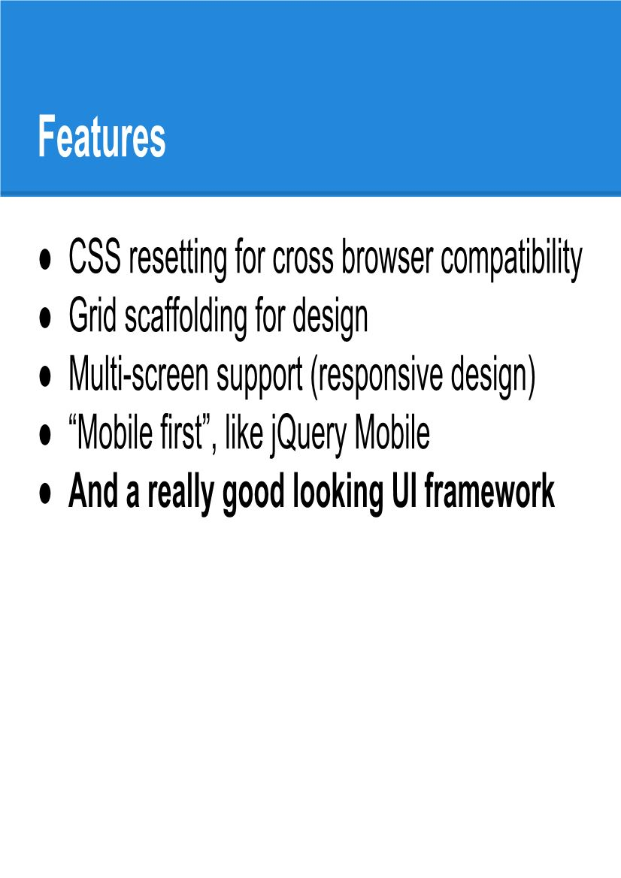

Slide 4
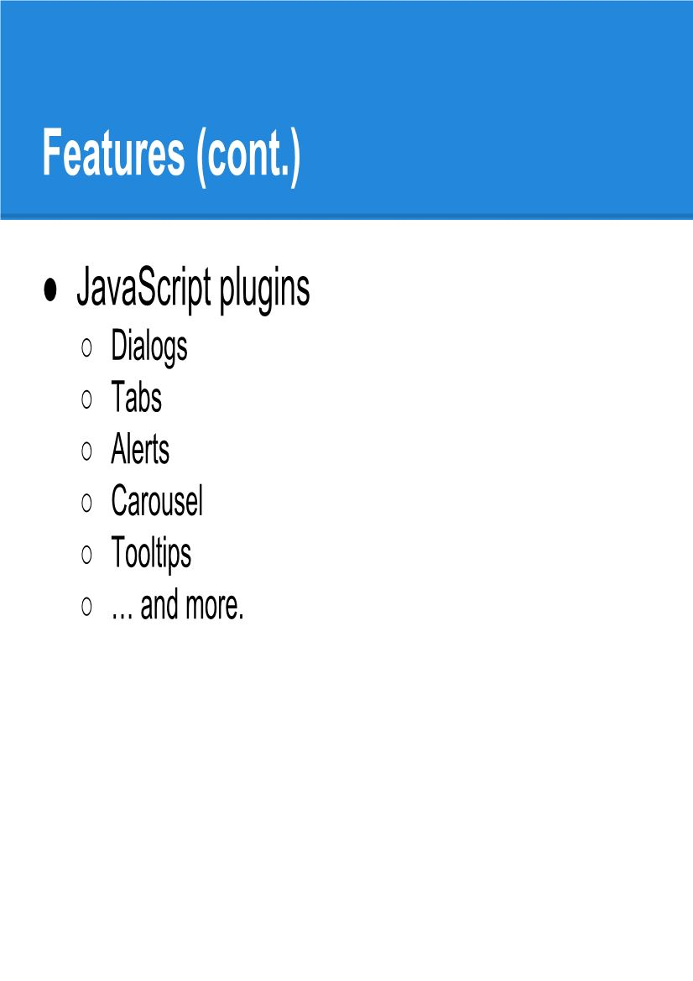

Slide 5
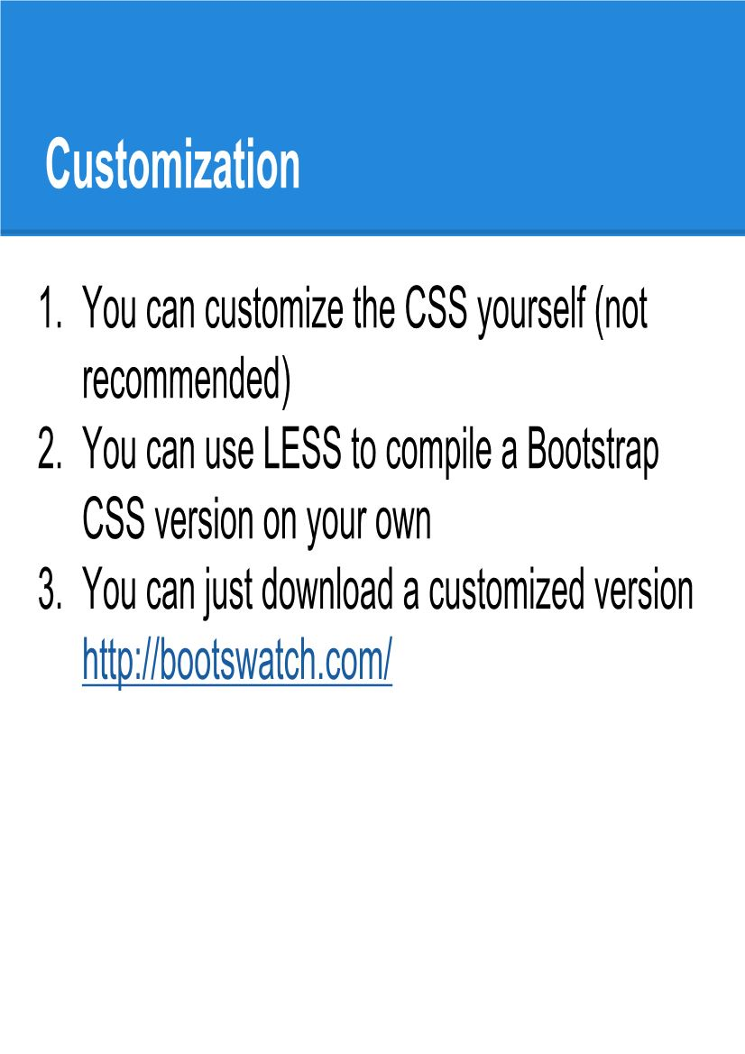

Slide 6
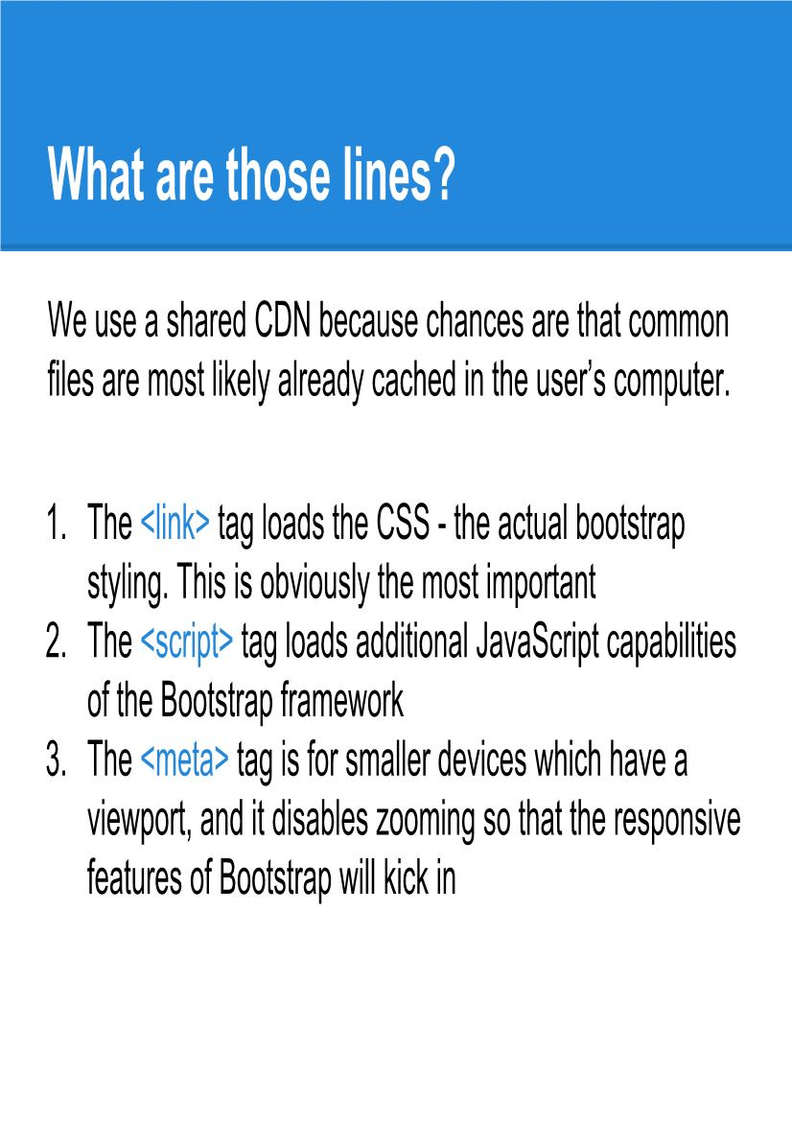

Slide 7
Units
px Pixels Most common; 1 px = one screen pixel (approx) width: 100px;
cm Centimeters 1 cm = 37.8 px width: 5cm;
mm Millimeters 1 mm = 1/10 of a cm margin: 10mm;
in Inches 1 in = 2.54 cm = 96 px height: 2in;
pt Points 1 pt = 1/72 inch font-size: 12pt;
pc Picas 1 pc = 12 points width: 3pc;
% Parent element Percentage of parent size width: 50%;
em Font size of the element (or parent) 1em = current font size padding: 2em;
rem Root element’s font size 1rem = root <html> font size margin: 1.5rem;

Slide 8
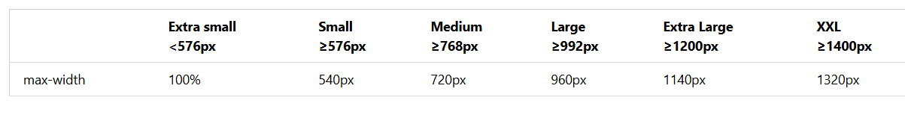
The .container class provides a responsive fixed width container
The .container-fluid class provides a full width container, spanning the entire width of the viewport
Use the .container class to create a responsive, fixed-width container.
Note that its width (max-width) will change on different screen sizes:
Sample : <div class="container p-5 m-5 bg-primary text-white"></div>
<p class="h1">h1 Bootstrap heading</p>
Colors : .bg-primary, .bg-success, .bg-info, .bg-warning, .bg-danger, .bg-secondary, .bg-dark and .bg-light.

Slide 9
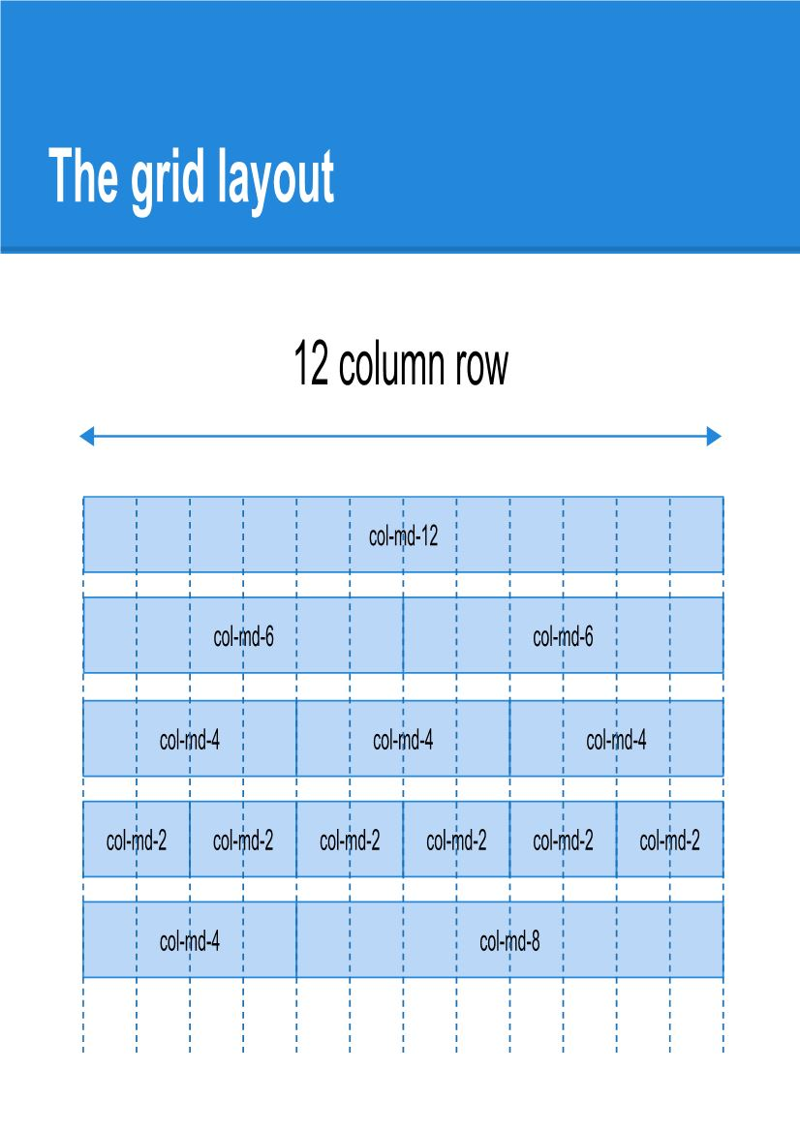

Slide 10
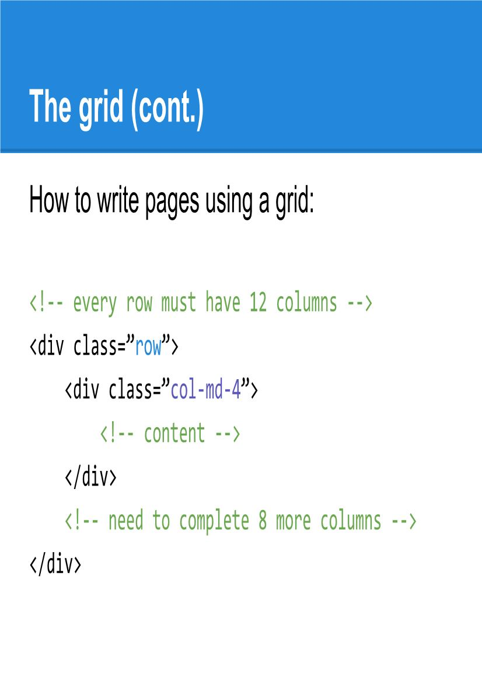

Slide 11
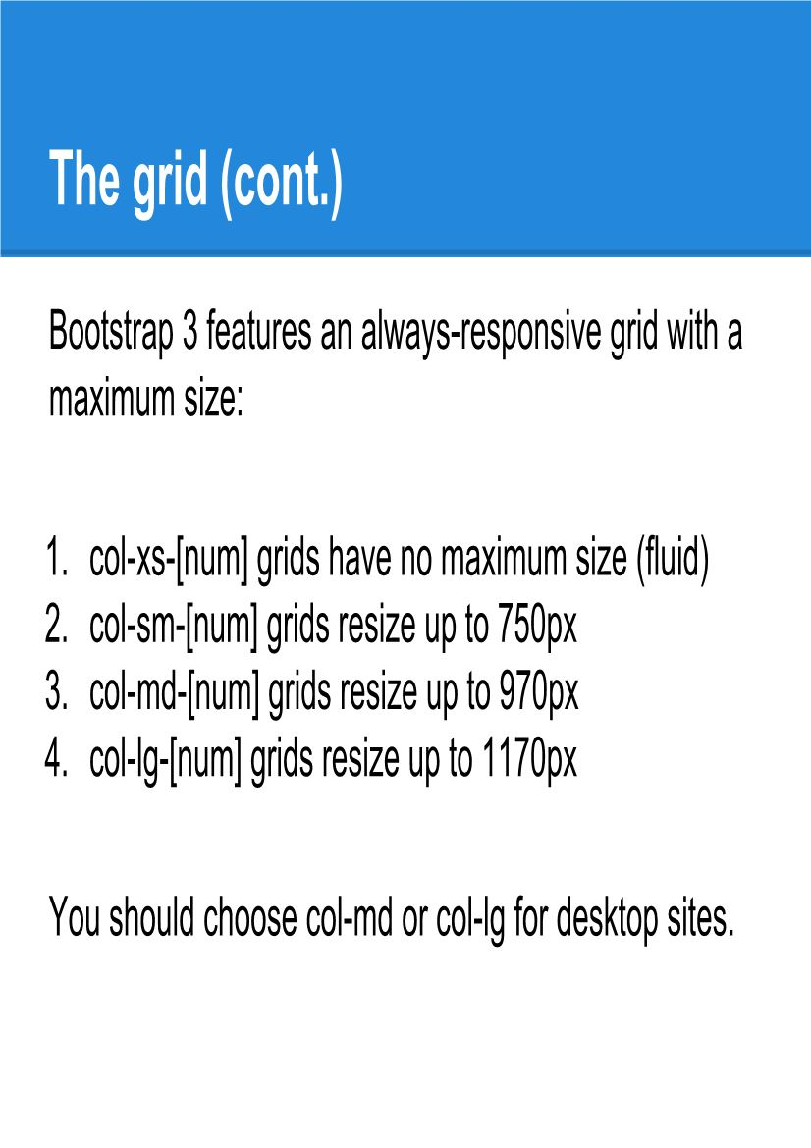

Slide 12
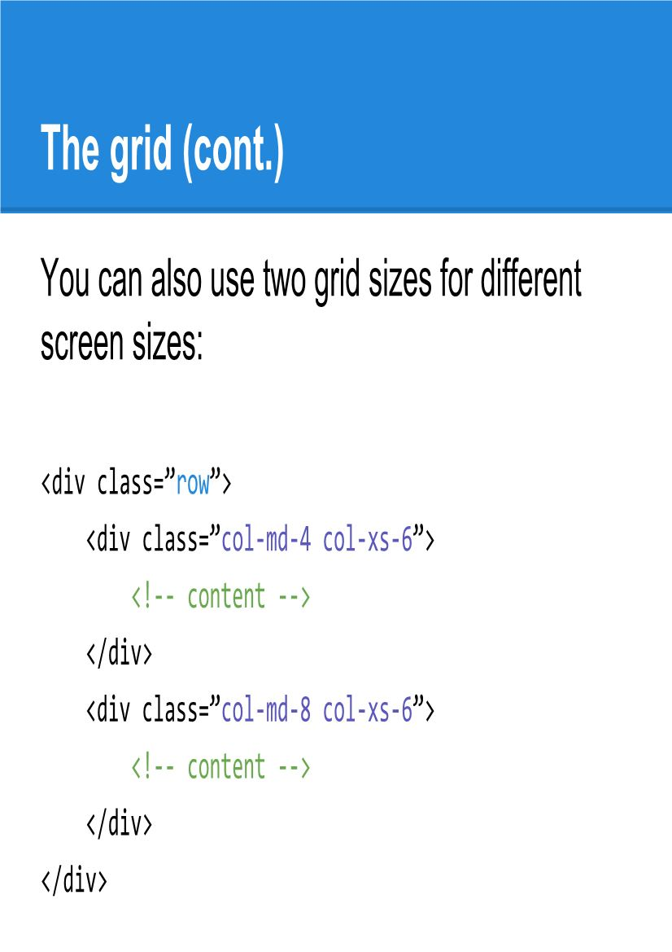

Slide 13
Alerts
Alerts are created with the .alert class, followed by one of the contextual classes
.alert-success,
.alert-info,
.alert-warning,
.alert-danger,
.alert-primary,
.alert-secondary,
.alert-light
.alert-dark:
div class="alert alert-success">
Add the .alert-link class to any links inside the alert box to create "matching colored links":
<div class="alert alert-success">
<strong>Success!</strong> You should <a href="#" class="alert-link">read this message</a>.
</div>

Slide 14
Buttons
<button type="button" class="btn">Basic</button>
<button type="button" class="btn btn-primary">Primary</button>
<button type="button" class="btn btn-secondary">Secondary</button>
<button type="button" class="btn btn-success">Success</button>
<button type="button" class="btn btn-info">Info</button>
<button type="button" class="btn btn-warning">Warning</button>
<button type="button" class="btn btn-danger">Danger</button>
<button type="button" class="btn btn-dark">Dark</button>
<button type="button" class="btn btn-light">Light</button>
<button type="button" class="btn btn-link">Link</button>
Explore Other Bootstrap Elements like card etc

Slide 15
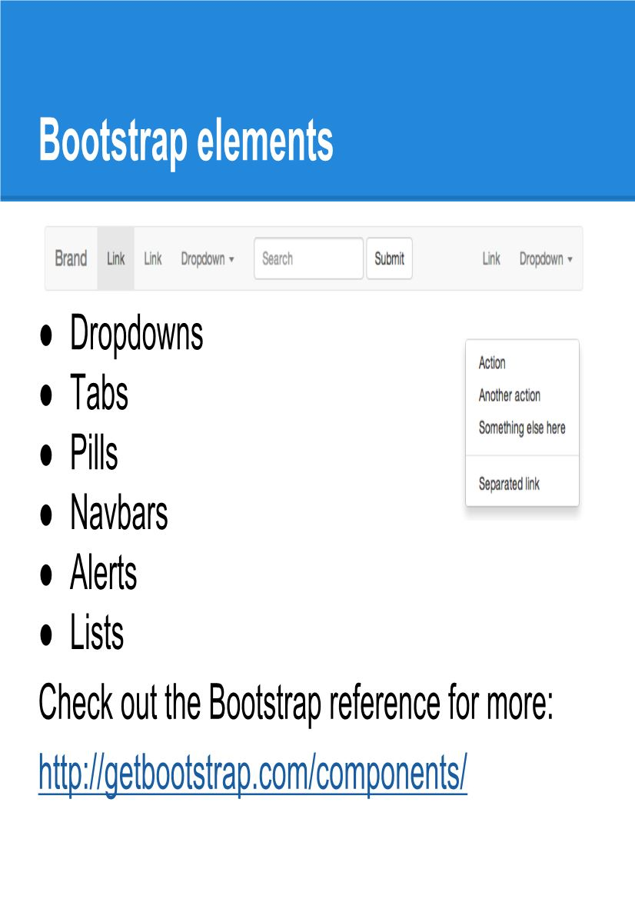

Slide 16
